Slide 1
BITS Pilani
Dr. Lavika Goel
Assistant Professor
Department of CSIS
Pilani Campus

Slide 2
Language description: Syntactic structure
Pilani Campus

Slide 3
Topics
Introduction
The General Problem of Describing Syntax
Formal Methods of Describing Syntax
BNF and context-free grammars
Derivation and Parse trees
Ambiguity in grammars
EBNF
Pilani Campus

Slide 4
Introduction
Syntax: the form or structure of the expressions, statements, and program units
Semantics: the meaning of the expressions, statements, and program units
Pilani Campus

Slide 5
Expression notations
Programming languages use a mix of infix, prefix and postfix notations.
Infix notation: precedence and associativity.
An operator at a higher precedence level (*, /) takes its operands before an operator at a lower precedence level (+, -).
Example, a + b * c, * is applied first between b and c, then addition is done between a and the result of (b*c).
a + b * c is equivalent to a + (b * c)
Without rules for specifying the relative precedence of operators, parenthesis would be needed to make explicit the operands of an infix operator.
Operators with the same precedence are grouped from left to right, example 4-2-1 is not equal to 4 - (2-1).
Left associative and right-associative operators: An operator is left-associative if sub-expressions containing multiple occurences of the operator are grouped from left to right and vice-versa for right associative operators. Example, +, -, /, * are left associative operators whereas exponentiation is right associative.
Pilani Campus

Slide 6
Abstract Syntax Trees
Abstract syntax of a language identifies the meaningful components of each construct in the language.
Example, +ab, a+b and ab+ have the same abstract syntax tree.
A better grammar can be designed if the abstract syntax of a language is known before the grammar is specified.
Tree representation of expressions: example, a+b and b*b -4*a*c
Tree showing the operator / operand structure of an expression is called an abstract syntax tree because they show the syntactic structure of an expression independent of the notation in which the expression was originally written.
Pilani Campus

Slide 7
The General Problem of Describing Syntax: Terminology
A sentence is a string of characters from some alphabet
A language is a set of sentences
A lexeme is the lowest level syntactic unit of a language (e.g., numeric literals, operators, special symbols, etc.)
A token is a category of lexemes (e.g., identifier)
Pilani Campus

Slide 8
Example
Pilani Campus

Slide 9
Formal Definition of Languages
Recognizers
A recognition device reads input strings over the alphabet of the language and decides whether the input strings belong to the language
Example: syntax analysis part of a compiler
Generators
A device that generates sentences of a language
One can determine if the syntax of a particular sentence is syntactically correct by comparing it to the structure of the generator
Pilani Campus

Slide 10
BNF and Context-Free Grammars
Context-Free Grammars
Developed by Noam Chomsky in the mid-1950s
Language generators, meant to describe the syntax of natural languages
Define a class of languages called context-free languages
Backus-Naur Form (1959)
Invented by John Backus to describe the syntax of Algol 58
BNF is equivalent to context-free grammars
Pilani Campus

Slide 11
BNF Fundamentals
In BNF, abstractions are used to represent classes of syntactic structures-they act like syntactic variables (abstractions are also called as nonterminal symbols)
Terminals are lexemes or tokens
A rule (or production) has a left-hand side (LHS), which is a nonterminal, and a right-hand side (RHS), which is a string of terminals and/or non-terminals.
Pilani Campus

Slide 12
BNF Fundamentals (continued)
Nonterminals are often enclosed in angle brackets
Example of BNF rule:
<if_stmt> → if <logic_expr> then <stmt>
Grammar: a finite non-empty set of rules
A start symbol is a special element of the nonterminals of a grammar
Pilani Campus

Slide 13
BNF Rules
An abstraction (or nonterminal symbol) can have more than one RHS
<stmt> → <single_stmt>
| begin <stmt_list> end
Another example:
Pilani Campus

Slide 14
Describing Lists
Syntactic lists are described using recursion
<ident_list> → ident
| ident, <ident_list>
Pilani Campus

Slide 15
Grammars and Derivations
A grammar is a generative device for defining languages.
The sentences of the language are generated through a sequence of applications of the rules, beginning with a special nonterminal of the grammar called the start symbol.
This sequence of rule applications is called a derivation. A derivation is a repeated application of rules, starting with the start symbol and ending with a sentence (all terminal symbols)
Pilani Campus
Notes:
In a grammar for a complete programming language, the start symbol represents a complete program and is often named <program>.

Slide 16
Derivations
Every string of symbols in a derivation is a sentential form
A sentence is a sentential form that has only terminal symbols
A leftmost derivation is one in which the leftmost nonterminal in each sentential form is the one that is expanded.
Derivation continues until the sentential form contains no non-terminals.
Derivation order has no effect on the language generated by the grammar.
Pilani Campus

Slide 17
A grammar for a small Language
<program> -> begin <stmt_list> end
< stmt_list> -> <stmt> | <stmt>;< stmt_list>
< stmt> -> <var> = <expression>
<var> -> A | B | C
<expression> -> <var> + <var>
| <var> - <var>
| <var>
Can this language accept these sentences?
begin
A=B+C; B=C
end
If yes how do we prove this?
Pilani Campus

Slide 18
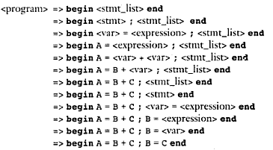
Derivation
Sentential form
Pilani Campus

Slide 19
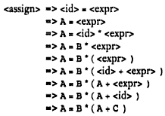
Left Derivation
Left-most derivation applies a production to the leftmost nonterminal at each step.
A = B * ( A + C )
<assign> -><id> = <expr>
<id> -> A | B | C
<expr> -> <id> + <expr>
| <id> * <expr>
| ( <expr> )
| <id>
Pilani Campus

Slide 20
Right Derivation
A right-most derivation applies a production rule to the rightmost nonterminal at each step.
Pilani Campus

Slide 21
A Grammar for Simple Assignment Statements
<assign> → <id> = <expr>
<id> → A | B | C
<expr> → <id> + <expr>
| <id> * <expr>
| ( <expr> )
| <id>
A = B * ( A + C )
<assign> => <id> = <expr>
=> <id>= <id>* <expr>
=> <id> = <id> * (<expr>)
=> <id> = <id> * (<id> + <expr>)
=> <id> = <id> * ( <id>+<id> )
=> <id> = <id> * ( <id> + C )
=> <id> = <id> * ( A + C )
=> <id> = B * (A + C)
=> A = B * ( A + C )
Pilani Campus
Notes:
The grammar of describes assignment statements whose right sides are arithmetic expressions with multiplication and addition operators and parentheses.

Slide 22
Parse Tree
A hierarchical representation of a derivation
Pilani Campus

Slide 23
Ambiguity in grammar
A grammar that generates two or more distinct parse trees is said to be ambiguous.
<assign> -> <id> = <expr>
<id> -> A | B | C
<expr> -> < expr > + <expr>
| < expr > * <expr>
| ( <expr> )
| <id>
A = B + C * A
Pilani Campus

Slide 24
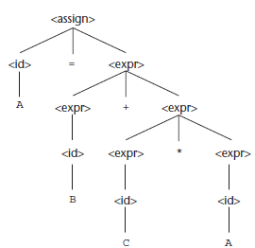
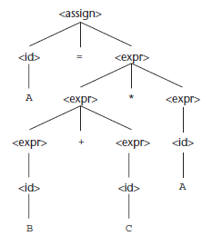
Two distinct parse trees
Pilani Campus
Notes:
There are several other characteristics of a grammar that are sometimes useful in determining whether a grammar is ambiguous.
They include the following:
if the grammar generates a sentence with more than one leftmost derivation and
if the grammar generates a sentence with more than one rightmost derivation. Some parsing algorithms can be based on ambiguous grammars.
When such a parser encounters an ambiguous construct, it uses nongrammatical information provided by the designer to construct the correct parse tree. In many cases, an ambiguous grammar can be rewritten to be unambiguous but still generate the desired language.

Slide 25
Resolving Ambiguity
If we use the parse tree to indicate precedence levels of the operators, we cannot have ambiguity as the grammar will specify a better syntactic structure.
If * is assigned a higher precedence than +, multiplication will be done first regardless of the order of appearance of the 2 operators in the expression.
The fact that an operator is generated lower in the parse tree indicates that it has precedence over an operator produced higher up in the tree.
In the first parse tree, since the * operator is generated lower in the tree, it has precedence over the + operator in the expression, and hence this parse tree is chosen.
Pilani Campus

Slide 26
Using Operator precedence for designing unambiguous grammar
A grammar can be written for the simple expressions that is both unambiguous and specifies a consistent operator precedence by using separate non-terminal symbols to represent the operands of the operators that have different precedence.
This requires additional non-terminals and new rules.
New non-terminals represent additional operands which allow the grammar to force different operators to different levels in the parse tree.
Pilani Campus

Slide 27
Using Operator precedence for designing unambiguous grammar
Pilani Campus

Slide 28
Derivation
Pilani Campus

Slide 29
Parse Tree
Parse tree generated is unique as the grammar is unambiguous.
Pilani Campus

Slide 30
Associativity of Operators
When the operators have the same precedence, semantic rule is required to specify the precedence, this is called as operator associativity.
Operator associativity can also be indicated by a grammar.
Left associativity can be represented by left-recursive grammars and vice-versa.
When a grammar rule has its LHS also appearing at the beginning of its RHS, the rule is said to be left recursive and vice-versa.
+, -, * , / are all left associative whereas exponentiation operation is right associative.
Pilani Campus

Slide 31
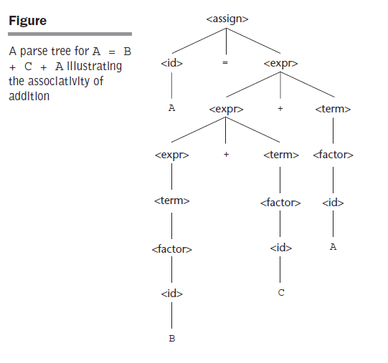
Example
Pilani Campus

Slide 32
Example
Right recursive grammar to represent the exponentiation operator which is right associative operator.
Pilani Campus

Slide 33
Derivations examples
Show a rightmost and leftmost derivation of abba in the grammar below.
<S> -> a<A> | b<A> | <A><B>
<A> -> a<A> | b | <S>
<B> -> <B>a | b
S => <A><B>
=> <A><B>a
=> <A>ba
=> a<A>ba
=> abba
S => <A><B>
=> a<A><B>
=> ab<B>
=> ab<B>a
=> abba
Pilani Campus

Slide 34
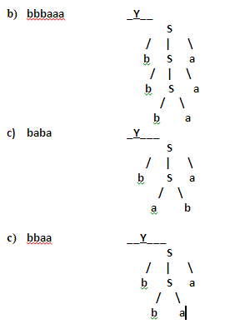
Exercise
Considering the grammar: <S> → b<S>a | ab | ba Indicate which of the following sentences cannot be generated with the above grammar?
(a) abba b. bbbaaa c. baba d. bbaa
Pilani Campus

Slide 35
Exercise
For the BNF definition X -> b | aaaXa | aaXaa, determine by derivation which of the string below is in the grammar(X).
(a) a⁷ba⁵ (b) a⁶ba⁴ (c) ab⁷a (d) aba
(a) a⁷ba⁵ (YES)
X=> a³Xa
=> a⁵Xa³
=> a⁷Xa⁵
=> a⁷ba⁵
Pilani Campus

Slide 36
Exercise
Given the following grammar in BNF:
<assign> -> <id> = <expr>
<id> -> A | B | C
<expr> -> <expr> + <term> | <term>
<term> -> <term> * <factor> | <factor>
<factor> -> (<expr> ) | <id>
Rewrite the given grammar to give + precedence over * and force + to be right associative.
Rewrite the given grammar to add ++ and - - unary operators of C language.
Pilani Campus

Slide 37
Solutions
<assign> -> <id> = <expr>
<id> -> A | B | C
<expr> -> <expr> * <term> | <term>
<term> -> <factor> + <term> | <factor>
<factor> -> ( <expr> ) | <id>
<assign> -> <id> = <expr>
<id> -> A | B | C
<expr> -> <expr> + <term> | <term>
<term> -> <term> * <factor> | <factor>
<factor> -> ( <expr> ) | <id> | <id> ++ | <id> -- | ++ <id> | -- <id>
Pilani Campus

Slide 38
More examples
<object> → <object> in <object> | <object> above <object> | <object> beside <object>
<object>→ <color> <object>
<object>→ circle | square | triangle
<color> -> red | blue | green
Question:
Precedence : in = above > beside
Associativity: Left
Solution:
<object> → <object> beside <term> | <term>
<term> → <term> in <factor> | <term> above <factor> | <factor>
<factor> → circle | square | triangle | <color> <factor>
<color> -> red | blue | green

Slide 39
Modify previous grammar for:
Question:
Precedence : beside > in > above
Associativity: Left
Solution:
<object> → <object> above <term> | <term>
<term> → <term> in <factor> | <factor>
<factor> → <factor> beside <var> | <var>
<var> → circle | square | triangle | <color> <var>
<color> -> red | blue | green

Slide 40
Modify previous grammar for:
Question:
Precedence : beside > in > above
Associativity: Right
Solution:
<object> → <term> above <object> | <term>
<term> → <factor> in <term> | <factor>
<factor> → <var> beside <factor> | <var>
<var> → circle | square | triangle | <color> <var>

Slide 41
More examples: CFG for a Function Declaration
int findFact(int a);
void checkFlag();
int fun1(int a, float b);
<funDecl> → <typeSpec> <funExpr>;
<typeSpec> → int | char | float |void
<funExpr> → FUNID( ) | FUNID ( <argList>)
<argList> → <typeSpec> ID | <typeSpec> ID , <argList>

Slide 42
Left Derivation
<funDecl> → <typeSpec> <funExpr>;
<typeSpec> → int | float |void
<funExpr> → FUNID( ) | FUNID ( <argList>)
<argList> → <typeSpec> ID | <typeSpec> ID , <argList>
int findFact(float a, int b);
<funDecl>→ <typeSpec> <funExpr>;
→ int <funExpr>;
→ int FUNID(<argList>);
→ int FUNID(<typeSpec> ID , <argList>);
→ int FUNID(float ID , <argList>);
→ int FUNID(float ID , <typeSpec> ID );
→ int FUNID(float ID, int ID);
Pilani Campus

Slide 43
Right Derivation
<funDecl> → <typeSpec> <funExpr>;
<typeSpec> → int | float |void
<funExpr> → FUNID( ) | FUNID ( <argList>)
<argList> → <typeSpec> ID | <typeSpec> ID , <argList>
int findFact(float a, int b);
<funDecl> → <typeSpec> <funExpr>;
→ <typeSpec> FUNID(<argList>);
→ <typeSpec> FUNID(<typeSpec> ID , <argList>);
→ <typeSpec> FUNID(<typeSpec> ID , <typeSpec> ID);
→ <typeSpec> FUNID(<typeSpec> ID , int ID);
→ <typeSpec> FUNID(float ID , int ID);
→ int FUNID(float ID , int ID );
Pilani Campus

Slide 44
Dangling Else Ambiguity
Pilani Campus

Slide 45
Example
Pilani Campus

Slide 46
Unambiguous grammar for if statement
Solution: ‘Else’ clause is matched with the nearest previous unmatched ‘then’.
There cannot be an if without an else between a then and its matching else.
Unmatched statements are else-less ifs.
Pilani Campus

Slide 47
Problems with BNF Notation
BNF notation is too long.
Must use recursion to specify repeated occurrences.
Must use separate an alternative for every option.
Pilani Campus

Slide 48
Extended BNF
Does not add any descriptive power but increases the readability and writability of BNF.
3 extensions to BNF:
Optional parts of RHS are placed in brackets [ ]
Repetitions (0 or more) are placed inside braces { }
Multiple choice options or Alternative parts of RHSs are placed inside parentheses and separated via vertical bars
Pilani Campus

Slide 49
BNF and EBNF versions of an expression grammar
Pilani Campus

Slide 50
BNF to EBNF
Conversion of BNF to EBNF:
(i) Look for recursion in grammar:
A-> aA |a
A-> a{a}
(ii) Look for common string that can be factored out with grouping and options.
A ->aB |a
A -> a [B]
Pilani Campus

Slide 51
EBNF to BNF
EBNF to BNF:
Option: []
A-> a[B]C
A’->aNC N->B| ε
Repetition: {}
A ->a{ B1B2... Bn}C
A’->aNC N->B1B2...BnN| ε
Pilani Campus

Slide 52
Example
Convert the following BNF to EBNF. Assume that <S> is the starting symbol
S → A | AC
C → bA | bAC
A → aD| abD
D → z
S → A { bA }
A → a [b] D
D → z
Pilani Campus

Slide 53
Example
Convert the following EBNF to BNF:
S → A { bA } { } repeat
A → a [b] D
D → z [ ] optional
BNF
S → A | AC
C → bA | bAC
A → aD | abD
D → z
Pilani Campus

Slide 54
Convert from BNF to EBNF
<funDecl> → <typeSpec> <funExpr>;
<typeSpec> → int | char | float |void
<funExpr> → FUNID( ) | FUNID ( <argList>)
<argList> → <typeSpecArg> ID | <typeSpecArg> ID, <argList>
<typeSpecArg> → int | char | float
<funDecl> → <typeSpec> <funExpr>;
<typeSpec> → (int | char | float |void)
<funExpr> → FUNID ( [<argList>])
<argList> → <typeSpecArg> ID { “,” <typeSpecArg> ID }
<typeSpecArg> → (int | char | float)

Slide 55
Convert from BNF to EBNF
<decList> → <typeSpec> <varList>;
<typeSpec> → int | char | float
<varList> → ID | ID, <varList> | ID <assignOp> NUM
<assignOp> → =
<decList> → <typeSpec> <varList>;
<typeSpec> → (int | char | float)
<varList> → ID {, <ID>} [<assignOp> NUM]
<assignOp> → “=“

Slide 56
Convert from EBNF to BNF
Rewrite the following EBNF grammar in BNF.
<funDecl> → <typeSpec> <ident_list>;
<typeSpec> → (int | float | char)
<ident_list> → <identifier> {,<identifier}
<funDecl> → <typeSpec> <ident_list>;
< typeSpec > → int | float | char
<ident_list> → <identifier> | <identifier> ,<ident_list>

Slide 57
Convert from EBNF to BNF
Convert the following EBNF to BNF: <S> → <X> { <Y> <Z> } <X> → x (+ | - | * | /) x <Y> → yy <Z> → [z] w <Y>
where {, }, (, ), |, [, ] are EBNF metasymbols
<S> → <X> | <X> <R>
<R> → <Y> <Z> | <Y> <Z> <R>
<X> → x + x | x - x | x * x | x / x
<Y> → yy
<Z> → z w <Y> | w <Y>

Slide 58
EBNF
Associativity of operators cannot be represented in EBNF.
Pilani Campus

Slide 59
Recent Variations in EBNF
Alternative RHSs are put on separate lines instead of using a vertical bar
Use of a colon instead of ->
Use of _{opt} for optional parts in place of square brackets.
Use of oneof for choices
Pilani Campus

Slide 60
Summary
BNF and context-free grammars are equivalent meta-languages
Well-suited for describing the syntax of programming languages
Pilani Campus

